Slide 1
Status Report
2015.09.23
Nam Jong Woo

Slide 2
Action Item
Paper review
  Measurement of Inclusive W and Z Boson Production Cross Sections in pp Collisions at
ROOT
  Histogram

Slide 3


Paper Review
Measure W, Z production cross sections
  Proton-proton collision at
  From electron and muon final state
  Cross sections times branching fractions
  ≈ 12.21 (nb)
  ≈ 1.15 (nb)

Slide 4
CMS design
Silicon pixel, Strip tracker
  Record particle paths
Crystal ECAL
  Measures energies of electrons and photons
HCAL
  Measures energies of hadrons
Solenoid
  To bend paths of particles
Muon detector

Slide 5
W decays to charged lepton + neutrino
  Missing transverse energy
Z decays to two leptons
  same flavor opposite charge
  Reconstructed dilepton 60 < mass <120 GeV

Slide 6
ROOT Histogram
Histogram Classes
  TH[dimension][type]
  eg. TH1F : histogram with 1 float per channel.
  TH1 Constructor
  TH1F(“name”, “title”, “# of bins, x_min, x_max);

Slide 7
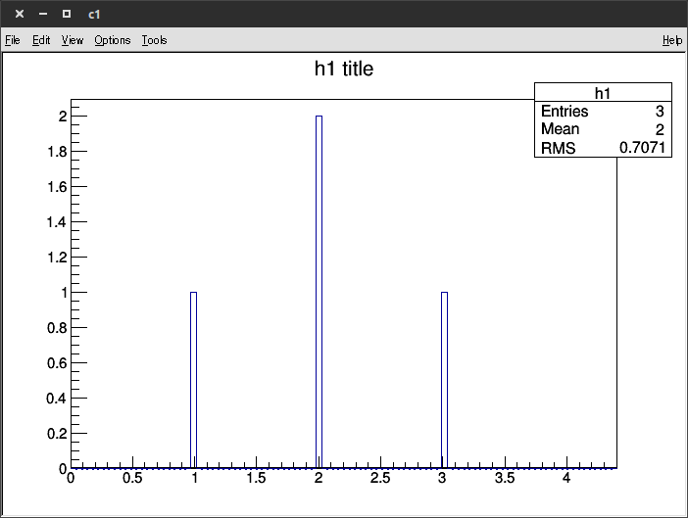
Histogram methods
Fill
  TH1 : Fill(x, weight)
  eg. h1→ Fill (1);
  h1→ Fill (2, 2);
  h1→ Fill (3);

Slide 8
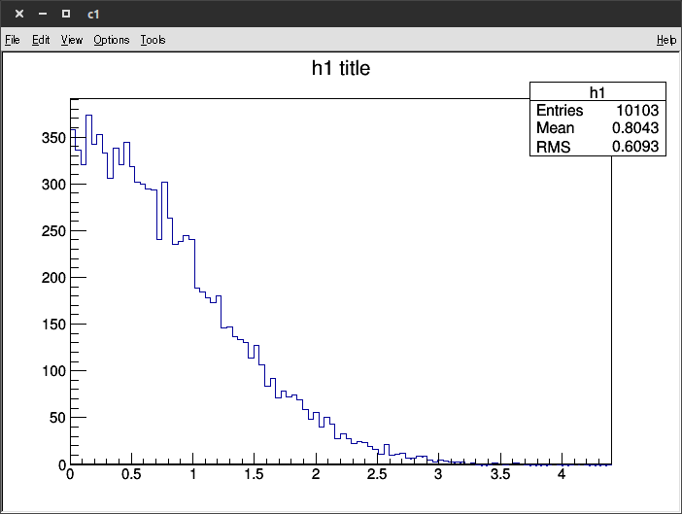
Histogram methods
FillRandom
  FillRandom(“distribution func”, # of entries);
  eg. h1 → FillRandom(“gaus”, 10100);

